Slide 1

Parking Management System by -: Shubham Raj ( 12109415 ) Mugle Sruthi ( 12109334 )

Slide 2
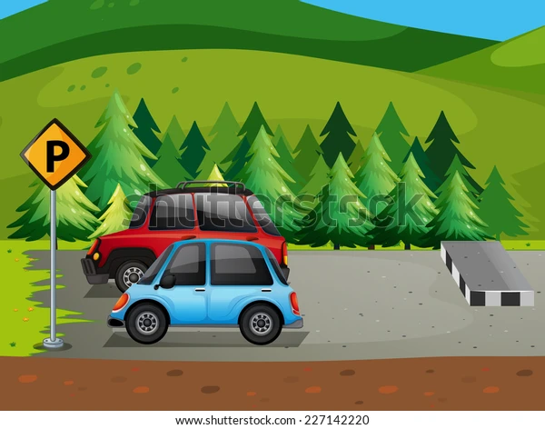
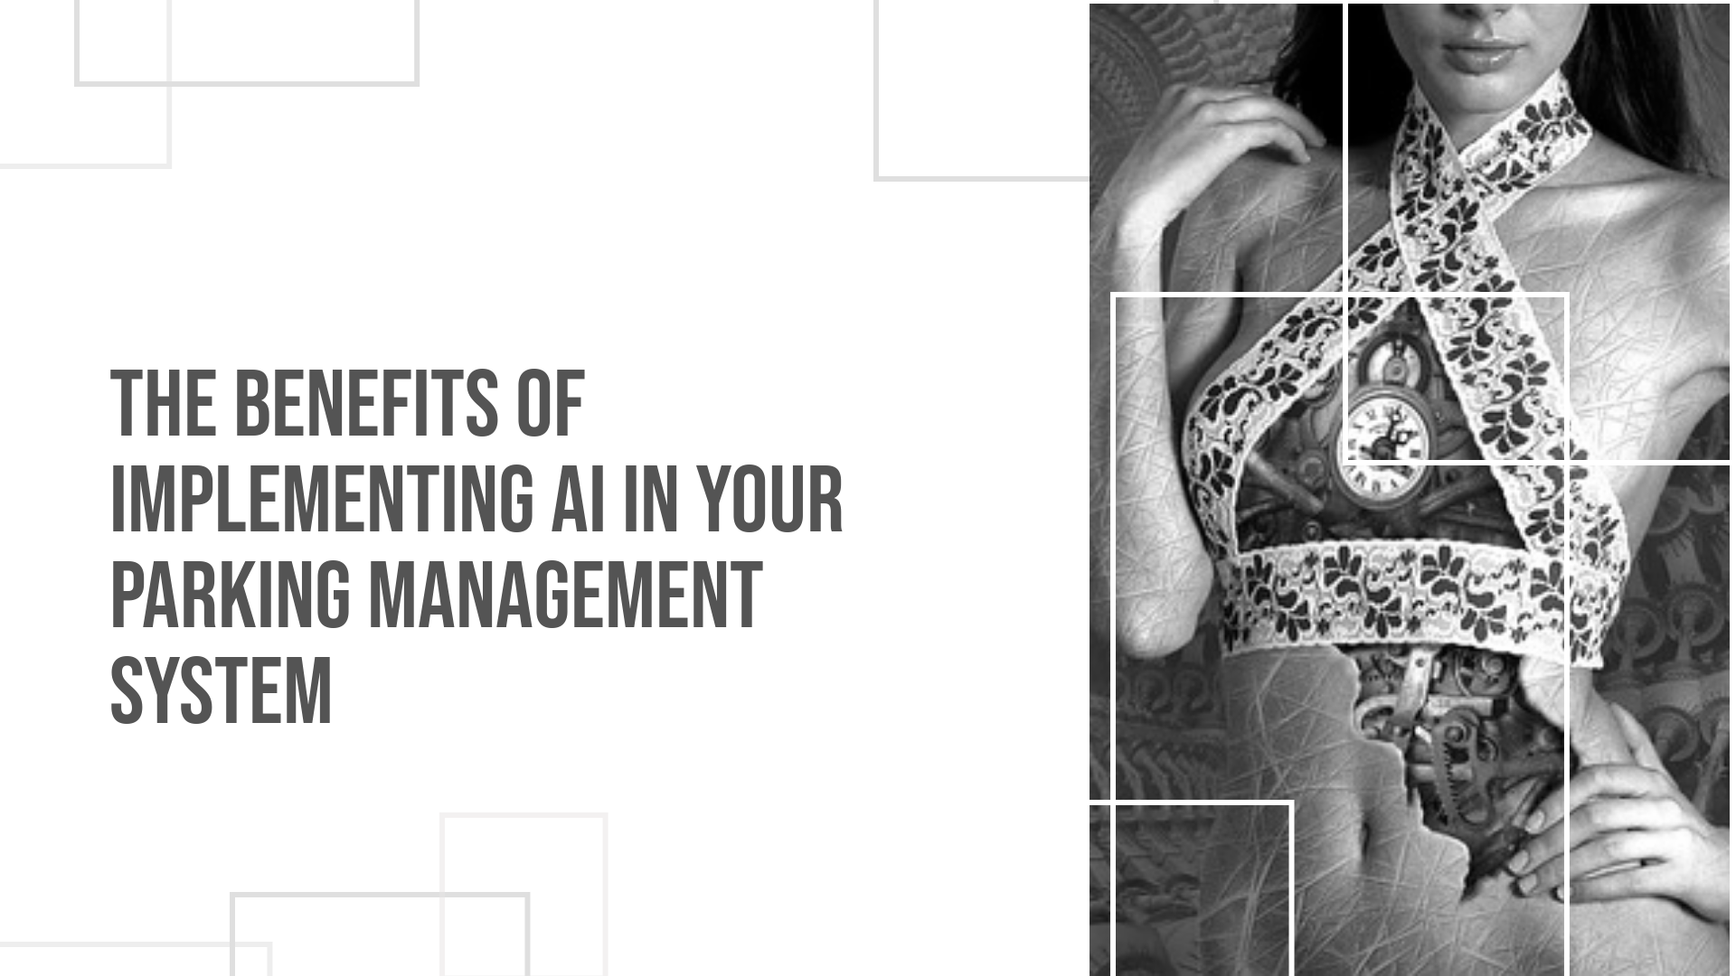

Slide 3
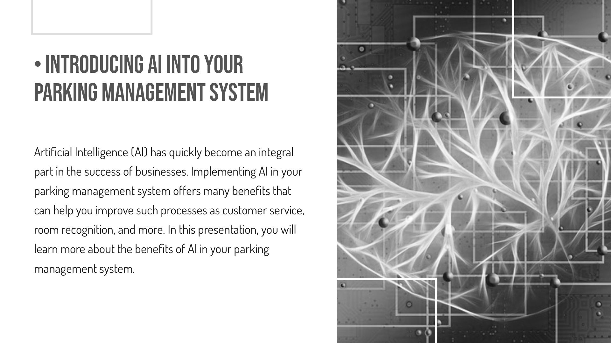

Slide 4
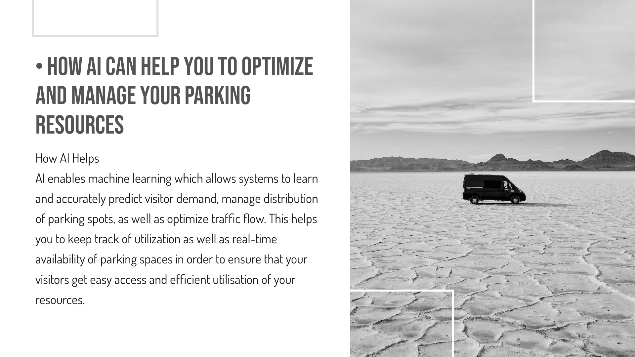

Slide 5

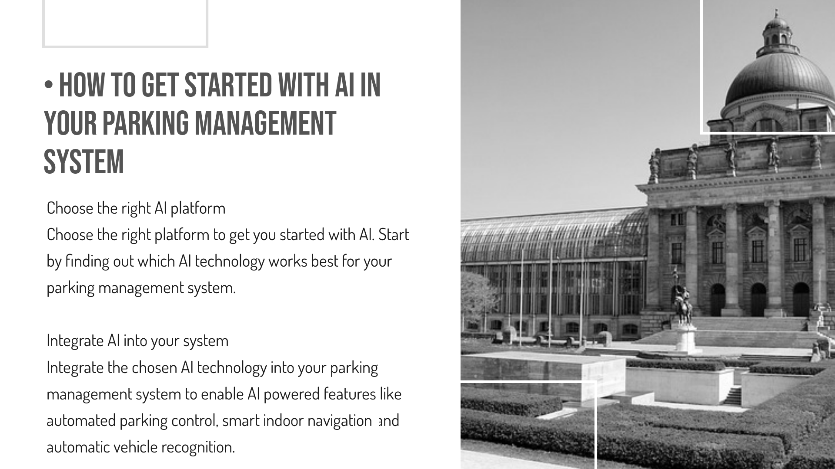

Slide 6
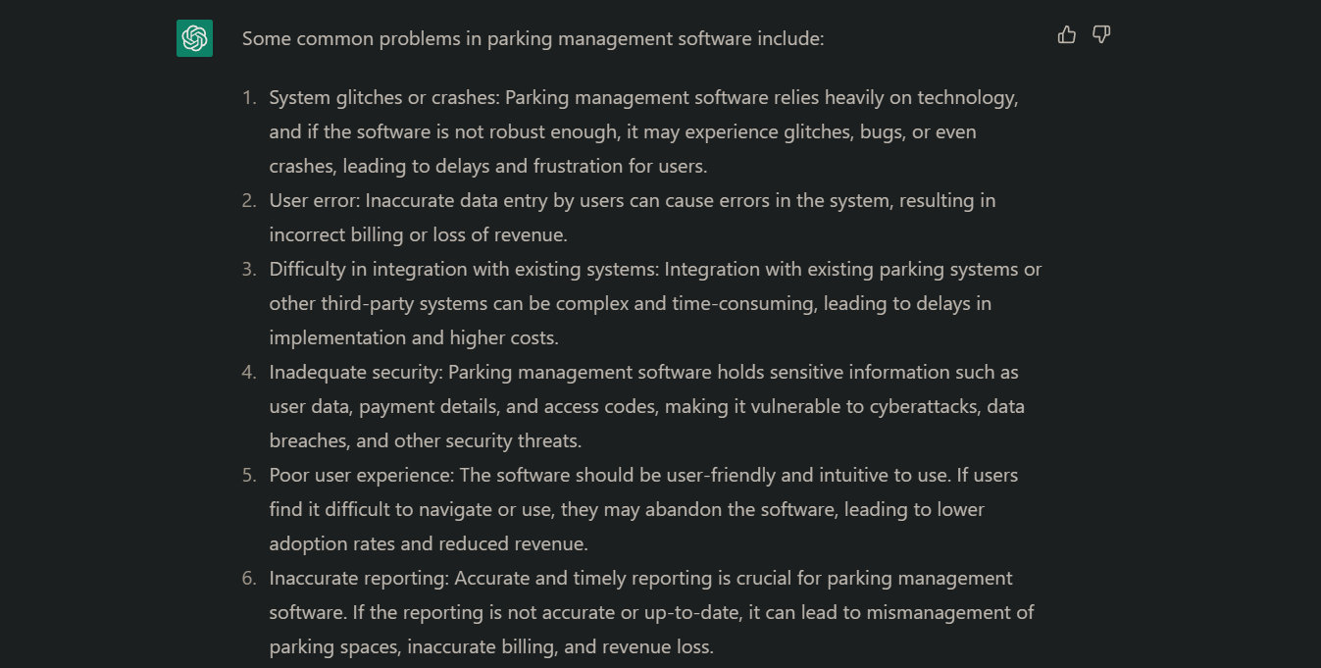

Slide 7
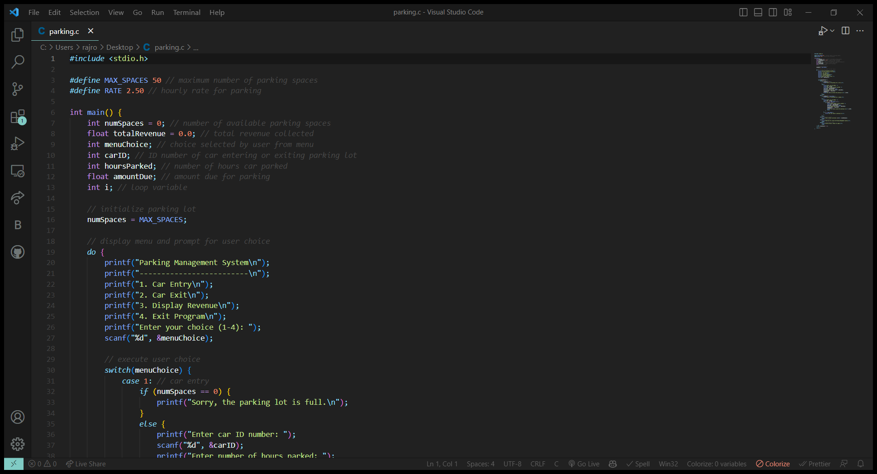

Slide 8
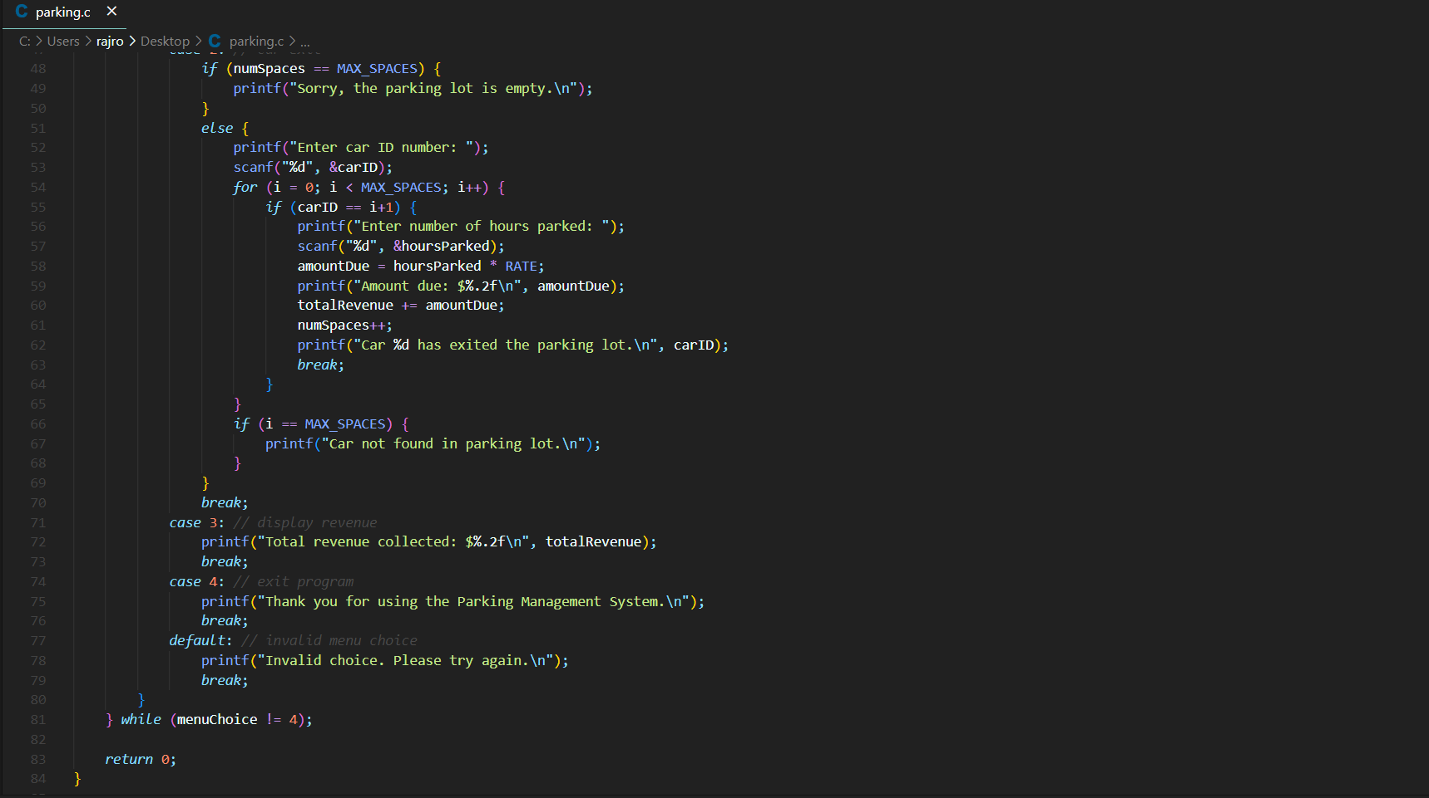

Slide 9
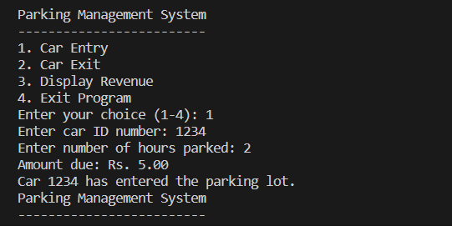
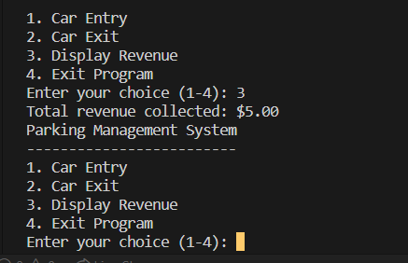
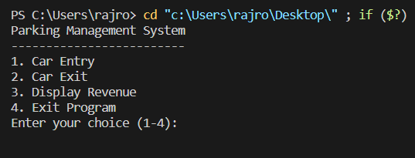

Slide 11


Parking Data Set
https://docs.google.com/spreadsheets/d/1WgXHiZVhNeH7ed_mqE-kvsGcOsWcAPlq2JgOjag4j68/edit?usp=share_link

Slide 12

SOURCE CODE
https://drive.google.com/file/d/1j1fg-TGKYc3Msu3FFNJWYuvq0F-fx5bV/view?usp=share_link

Slide 13

REPORT
https://drive.google.com/file/d/1zlZ7wBewH1qRXCWA3VB_WEoYqUFJYsuK/view?usp=share_link

Slide 14
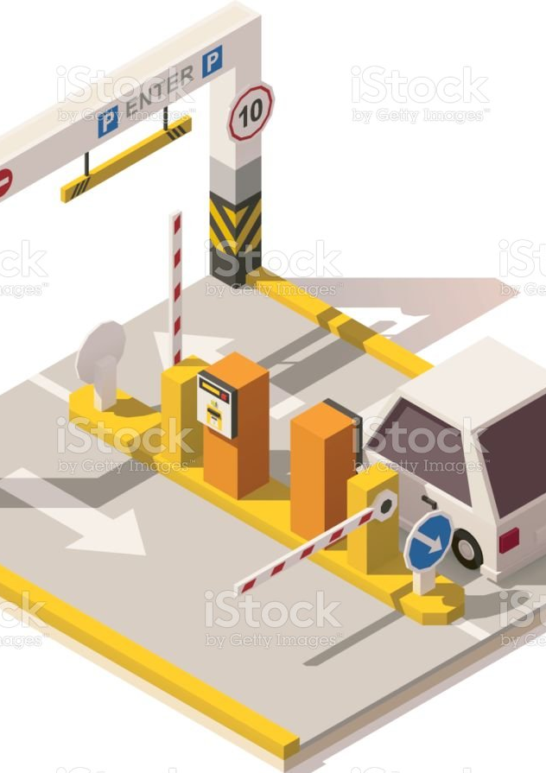


Slide 15
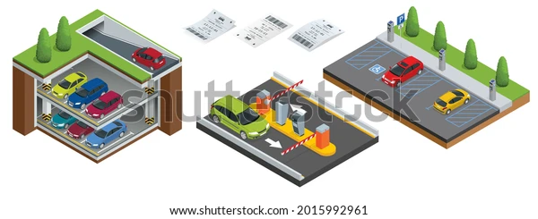

Slide 16


